Slide 1
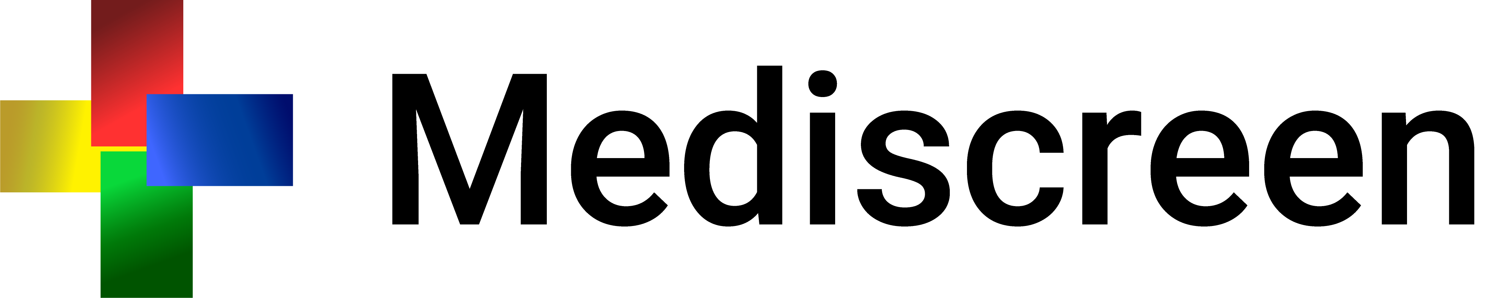

Slide 2
Summary
What is it about?
Technologies used
Architecture
Test coverage
Difficulties/solutions
Application

Slide 3
What is it about?
Mediscreen application is specialized in detecting risk factors for a disease.
Application allows to detect a level of risk of diabetes in a patient, based on his age, his sex and the different notes left by the doctor.

Slide 4




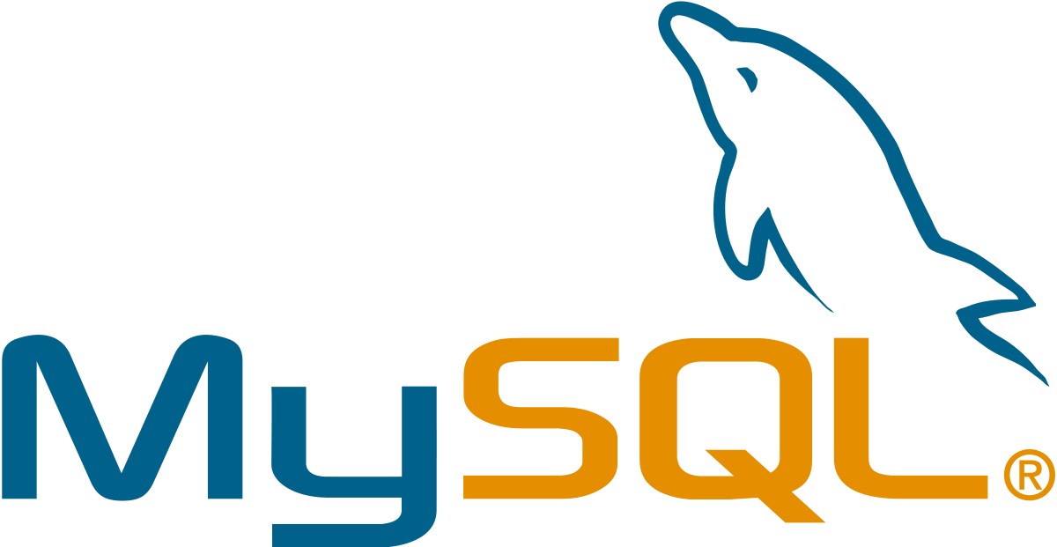


Technologies used

Slide 5
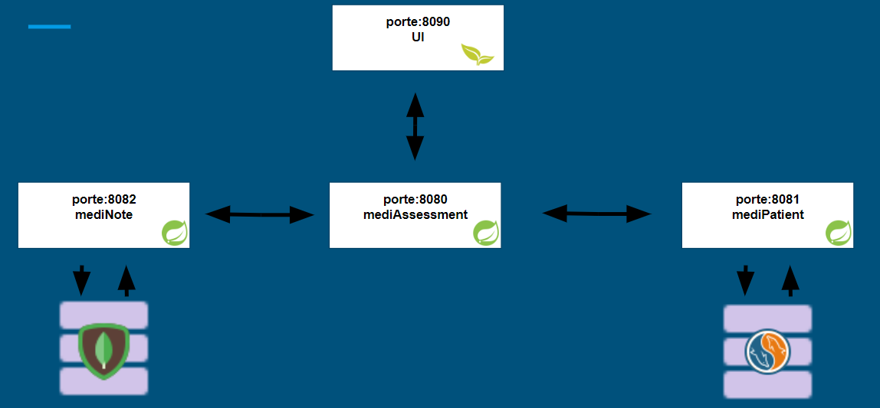
Microservice Architecture

Slide 6
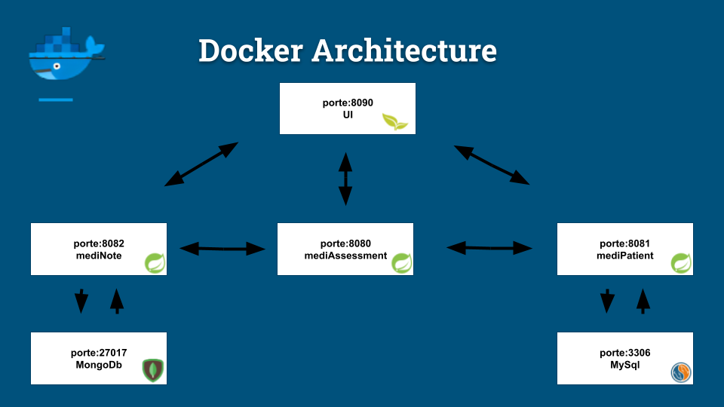
Docker Architecture

Slide 7
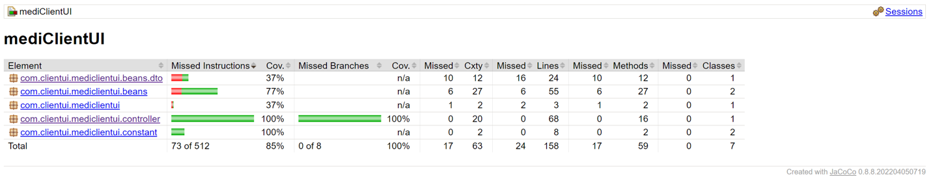
Test Coverage

Slide 8
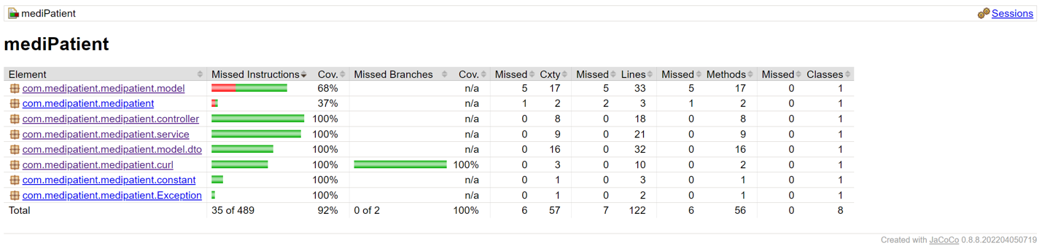
Test Coverage

Slide 9
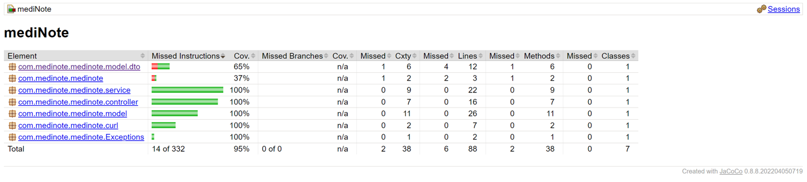
Test Coverage

Slide 10
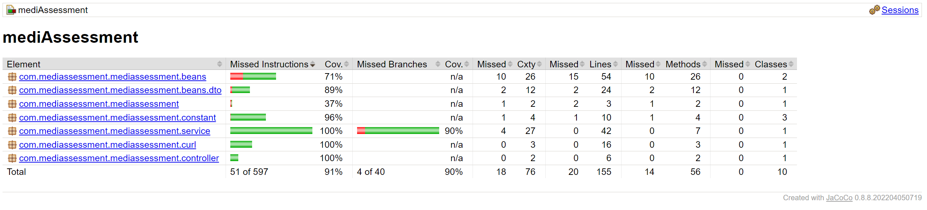
Test Coverage

Slide 11
Difficulties/solution
No SQL
How to set up a NoSQL database for notes?
Solution - Using MongoDB with the MongoRepository.

Slide 12
Thank you for your attention !

